Slide 1
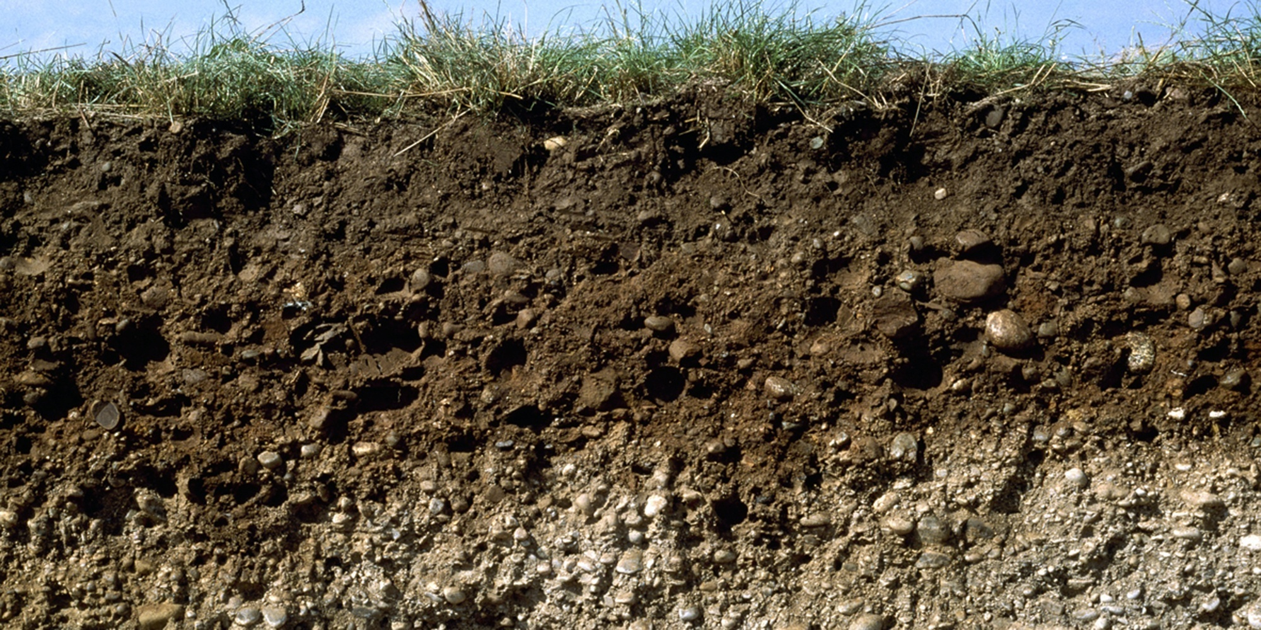

Soil science
Report writing
Guo-Shiuan Lin (Steven)
URBES lab, EPFL

Slide 2
Introduction (3-4 sentences)
Establishing importance
What is the big picture
Why is this topic important
Bring up the key terms
Identifying gap
What is the current research progress and the knowledge gap
Giving a focus/aim
What did we do
What are we going to present
Note: Don’t spoil the results and conclusion yet!

Slide 3
Methods (1/3~half page)
What theories and who made them?
  Key definitions
  Key equations
What input data
How is it modelled
  Technical details (e.g., Python functions with time step of 50 days, 2 soil types with fixed temperature…)
  Assumptions
Note: Explain as if you were speaking to someone with a white board

Slide 4
Results (half-0.8 page)
Figures + describing the figures:
  what are in the plots
  key values (e.g., saturation water content)
  trends, difference, unique/interesting things
Note: Be objective. Make sure every figure is explained

Slide 5
Discussion (1/3 ~ half page)
Explain the results
  Why this trend, difference, or interesting finding
  Relate to the research goal in Introduction
  Relate to literatures, course materials, real life
  Unexpected findings?
Future improvements?
Note: Interpret and dive deeper into the results

Slide 6
Conclusion (3 sentences)
Main findings/ key messages
Main application/implication from the findings

